Slide 1
08 – Introduction to Remote Sensing
Passive vs. active remote sensing
Common data types
Remote Sensing Platforms
Chair of Sensor-based Geoinformatics (geosense)
www.geosense.uni-freiburg.de

Slide 2
Difference active & passive remote sensing?
08 – Introduction to Remote Sensing

Slide 3
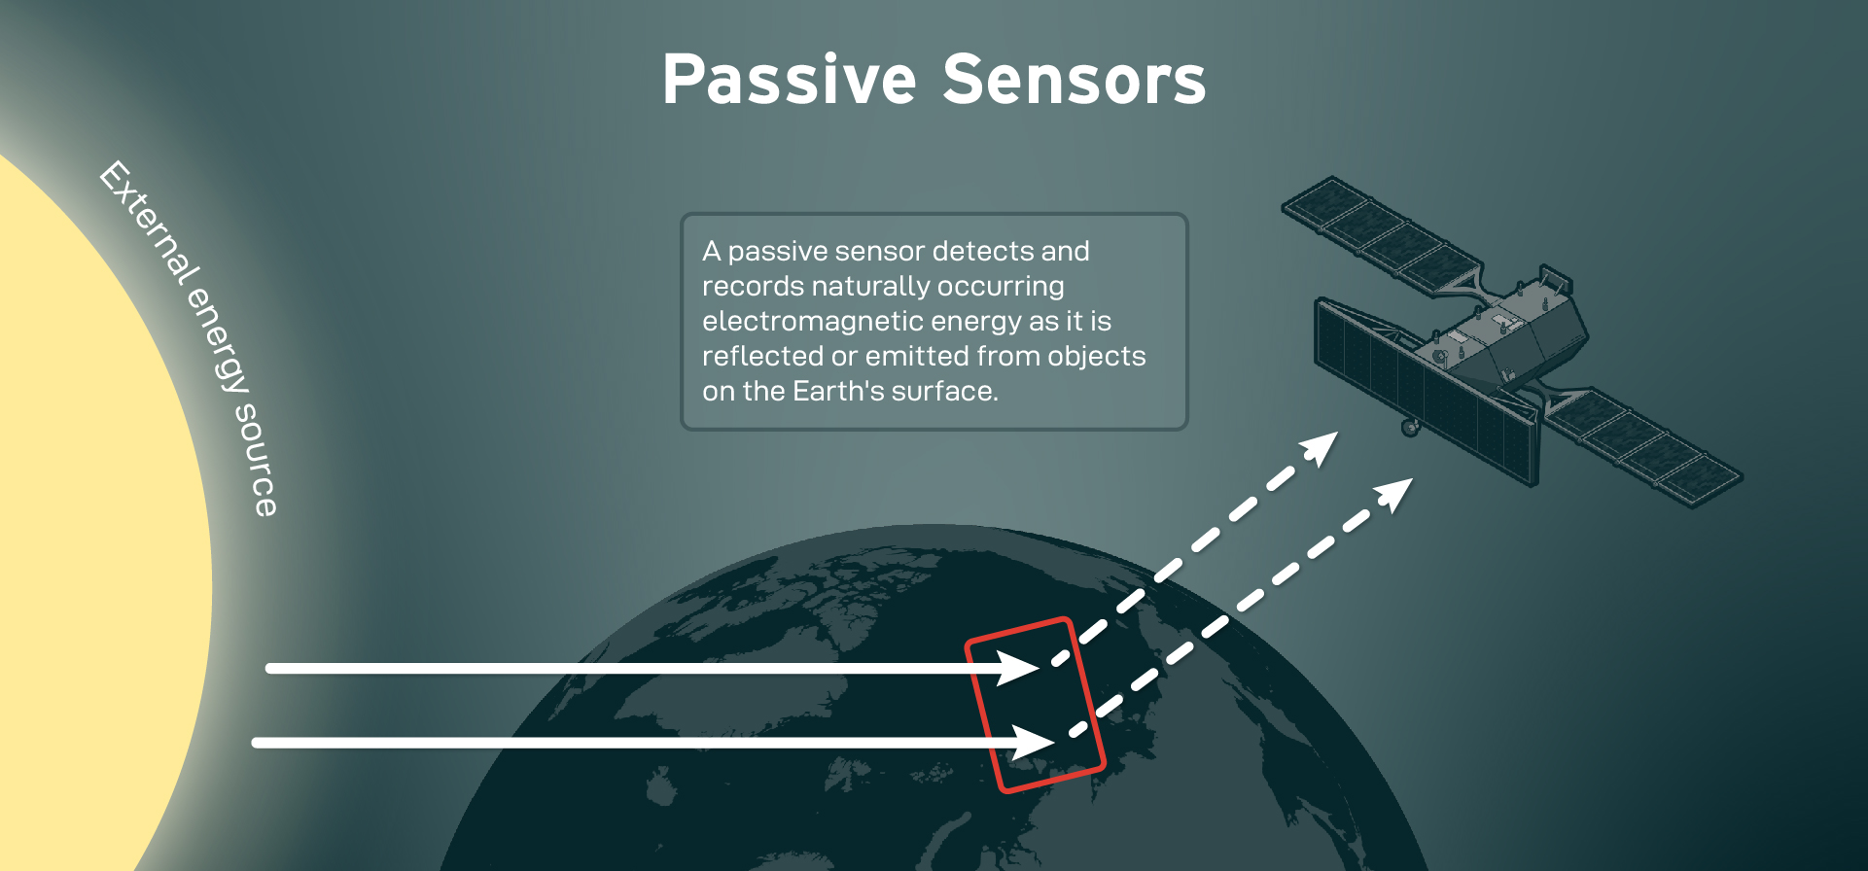
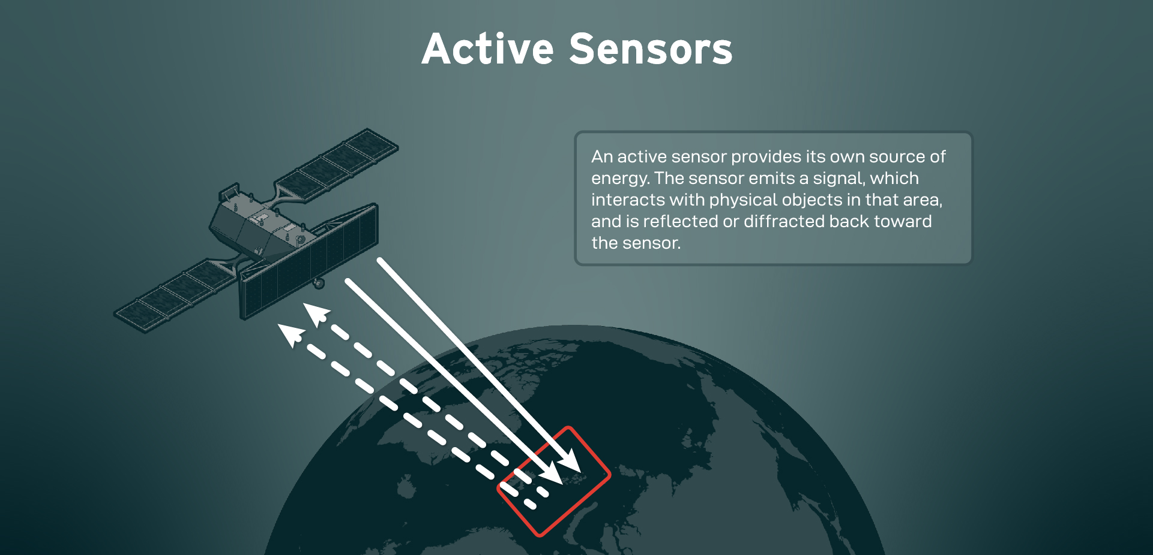
Passive vs. active remote sensing
Passive remote sensing
Reflected energy of another light source (e.g. sun) is recorded
Typical instrument: Camera, Linescanner
Active remote sensing
Energy is emitted (actively) and recorded
Typical instrument: Light Detection and Ranging (LiDAR), Radio and Ranging (RADAR)
Sketch Tablet
https://ursaspace.com/wp-content/uploads/2021/09/Remote20Sensing-02.jpg
https://ursaspace.com/wp-content/uploads/2021/09/Remote20Sensing-03.jpg

Slide 4
Passive vs. active remote sensing
Passive remote sensing
+ Easy to understand & acquire
+ Easy to interpet
- Dependency on sun (quantity/quality)
- Cannot penetrate objects (only 2D)
Active remote sensing
+ 3D or structural information
+ can be operated almost at any time
- Complex to operate and analyse
- Often expensive
Sketch Tablet
https://ursaspace.com/wp-content/uploads/2021/09/Remote20Sensing-02.jpg
https://ursaspace.com/wp-content/uploads/2021/09/Remote20Sensing-03.jpg

Slide 5
Common data types
08 – Introduction to Remote Sensing

Slide 6
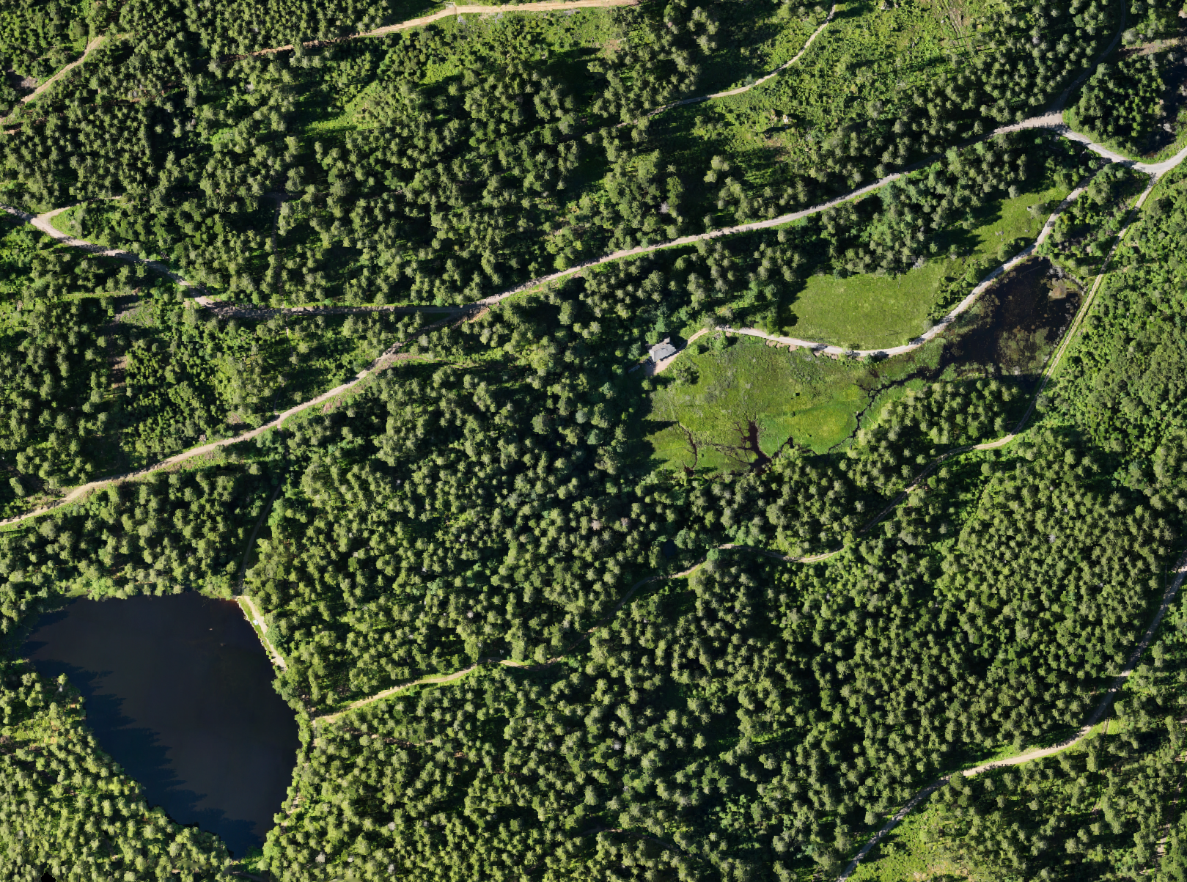
Rasters
Typical Sensors: Cameras, Linescanners
Ideal for continuous mapping in space and time
Structured as matrices
Easy to analyse (world as a grid)
Sometimes problematic (nature is no grid)

Slide 7
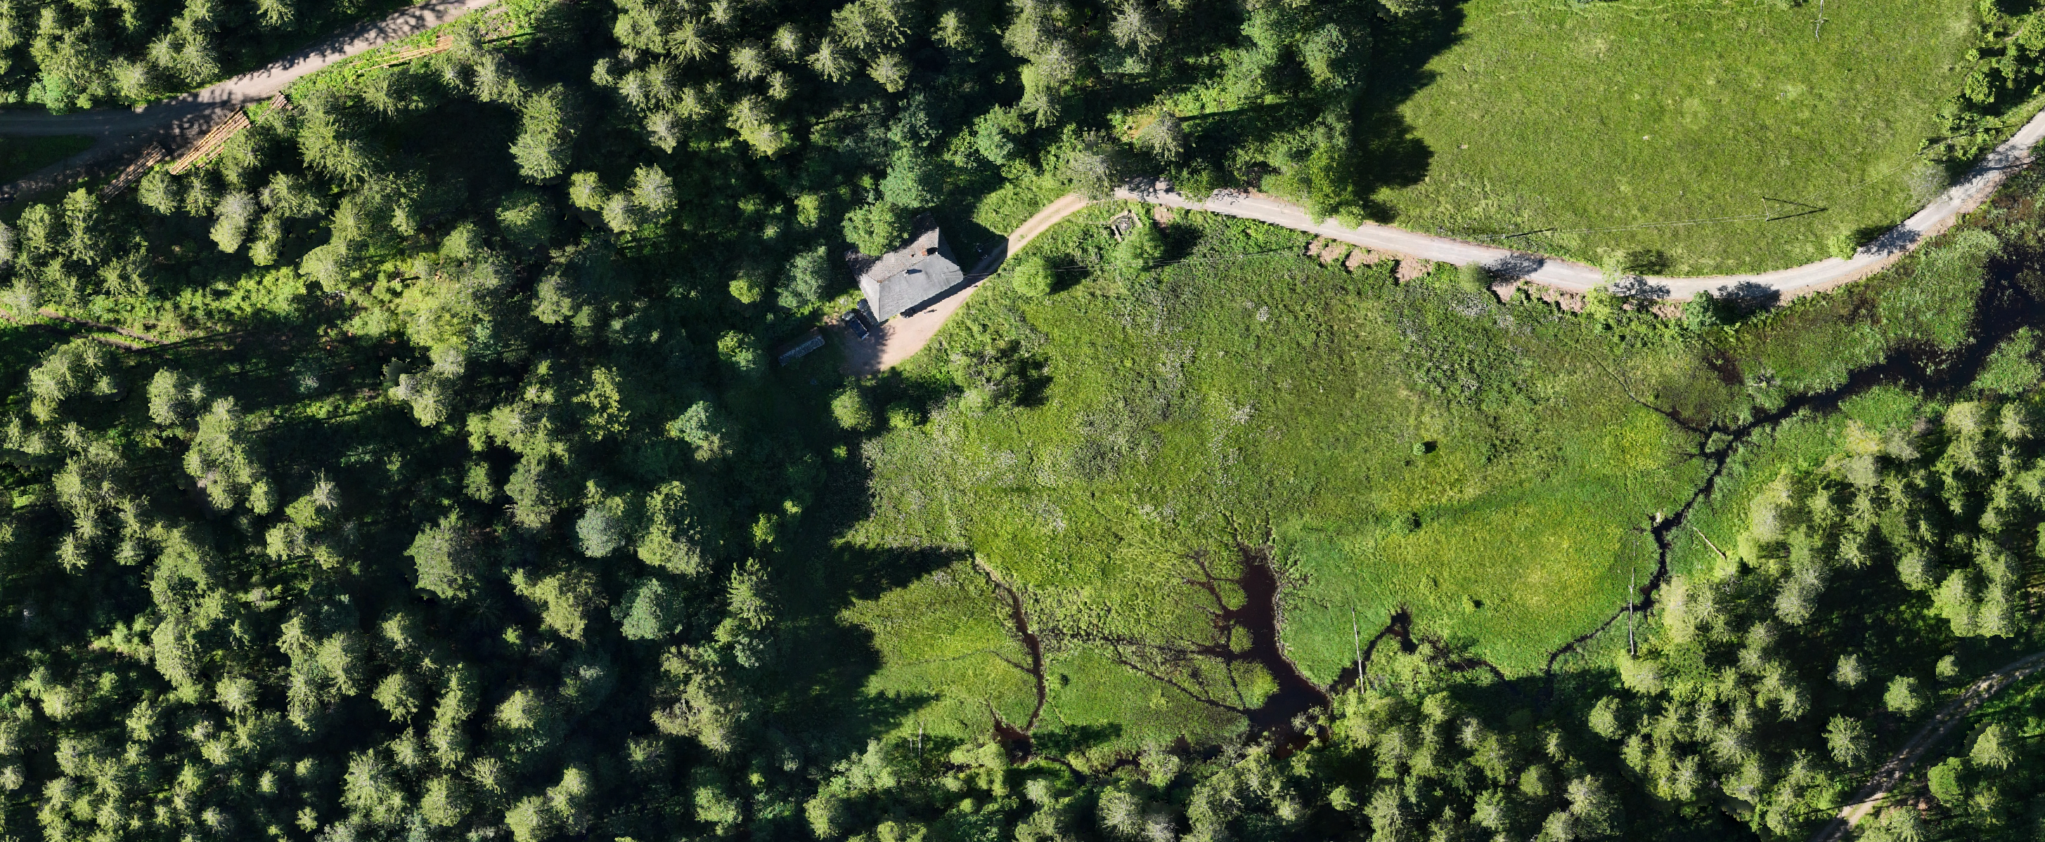

Slide 8
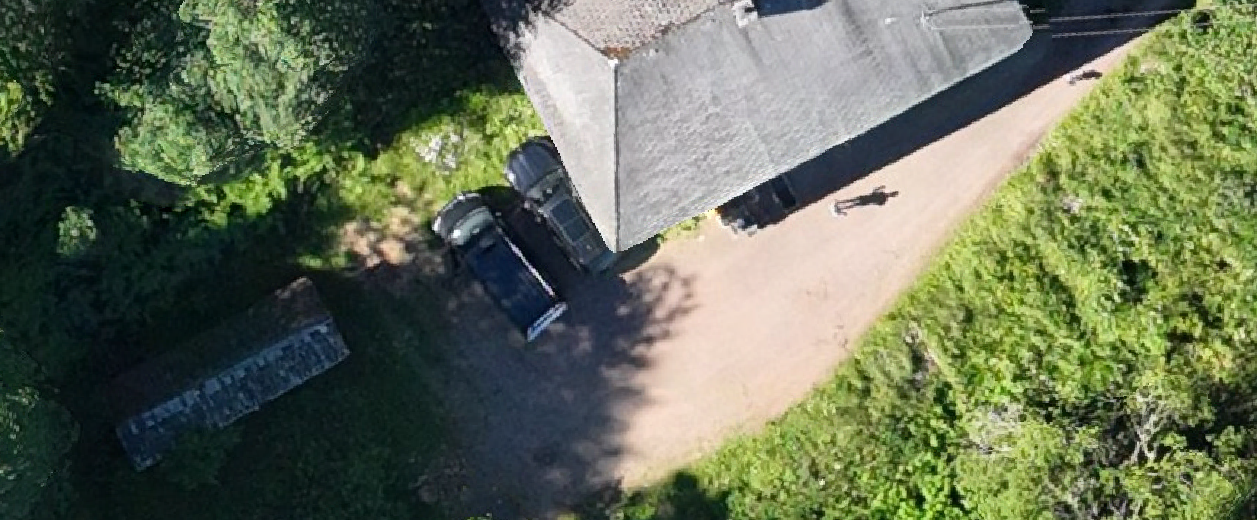

Slide 9


Slide 10
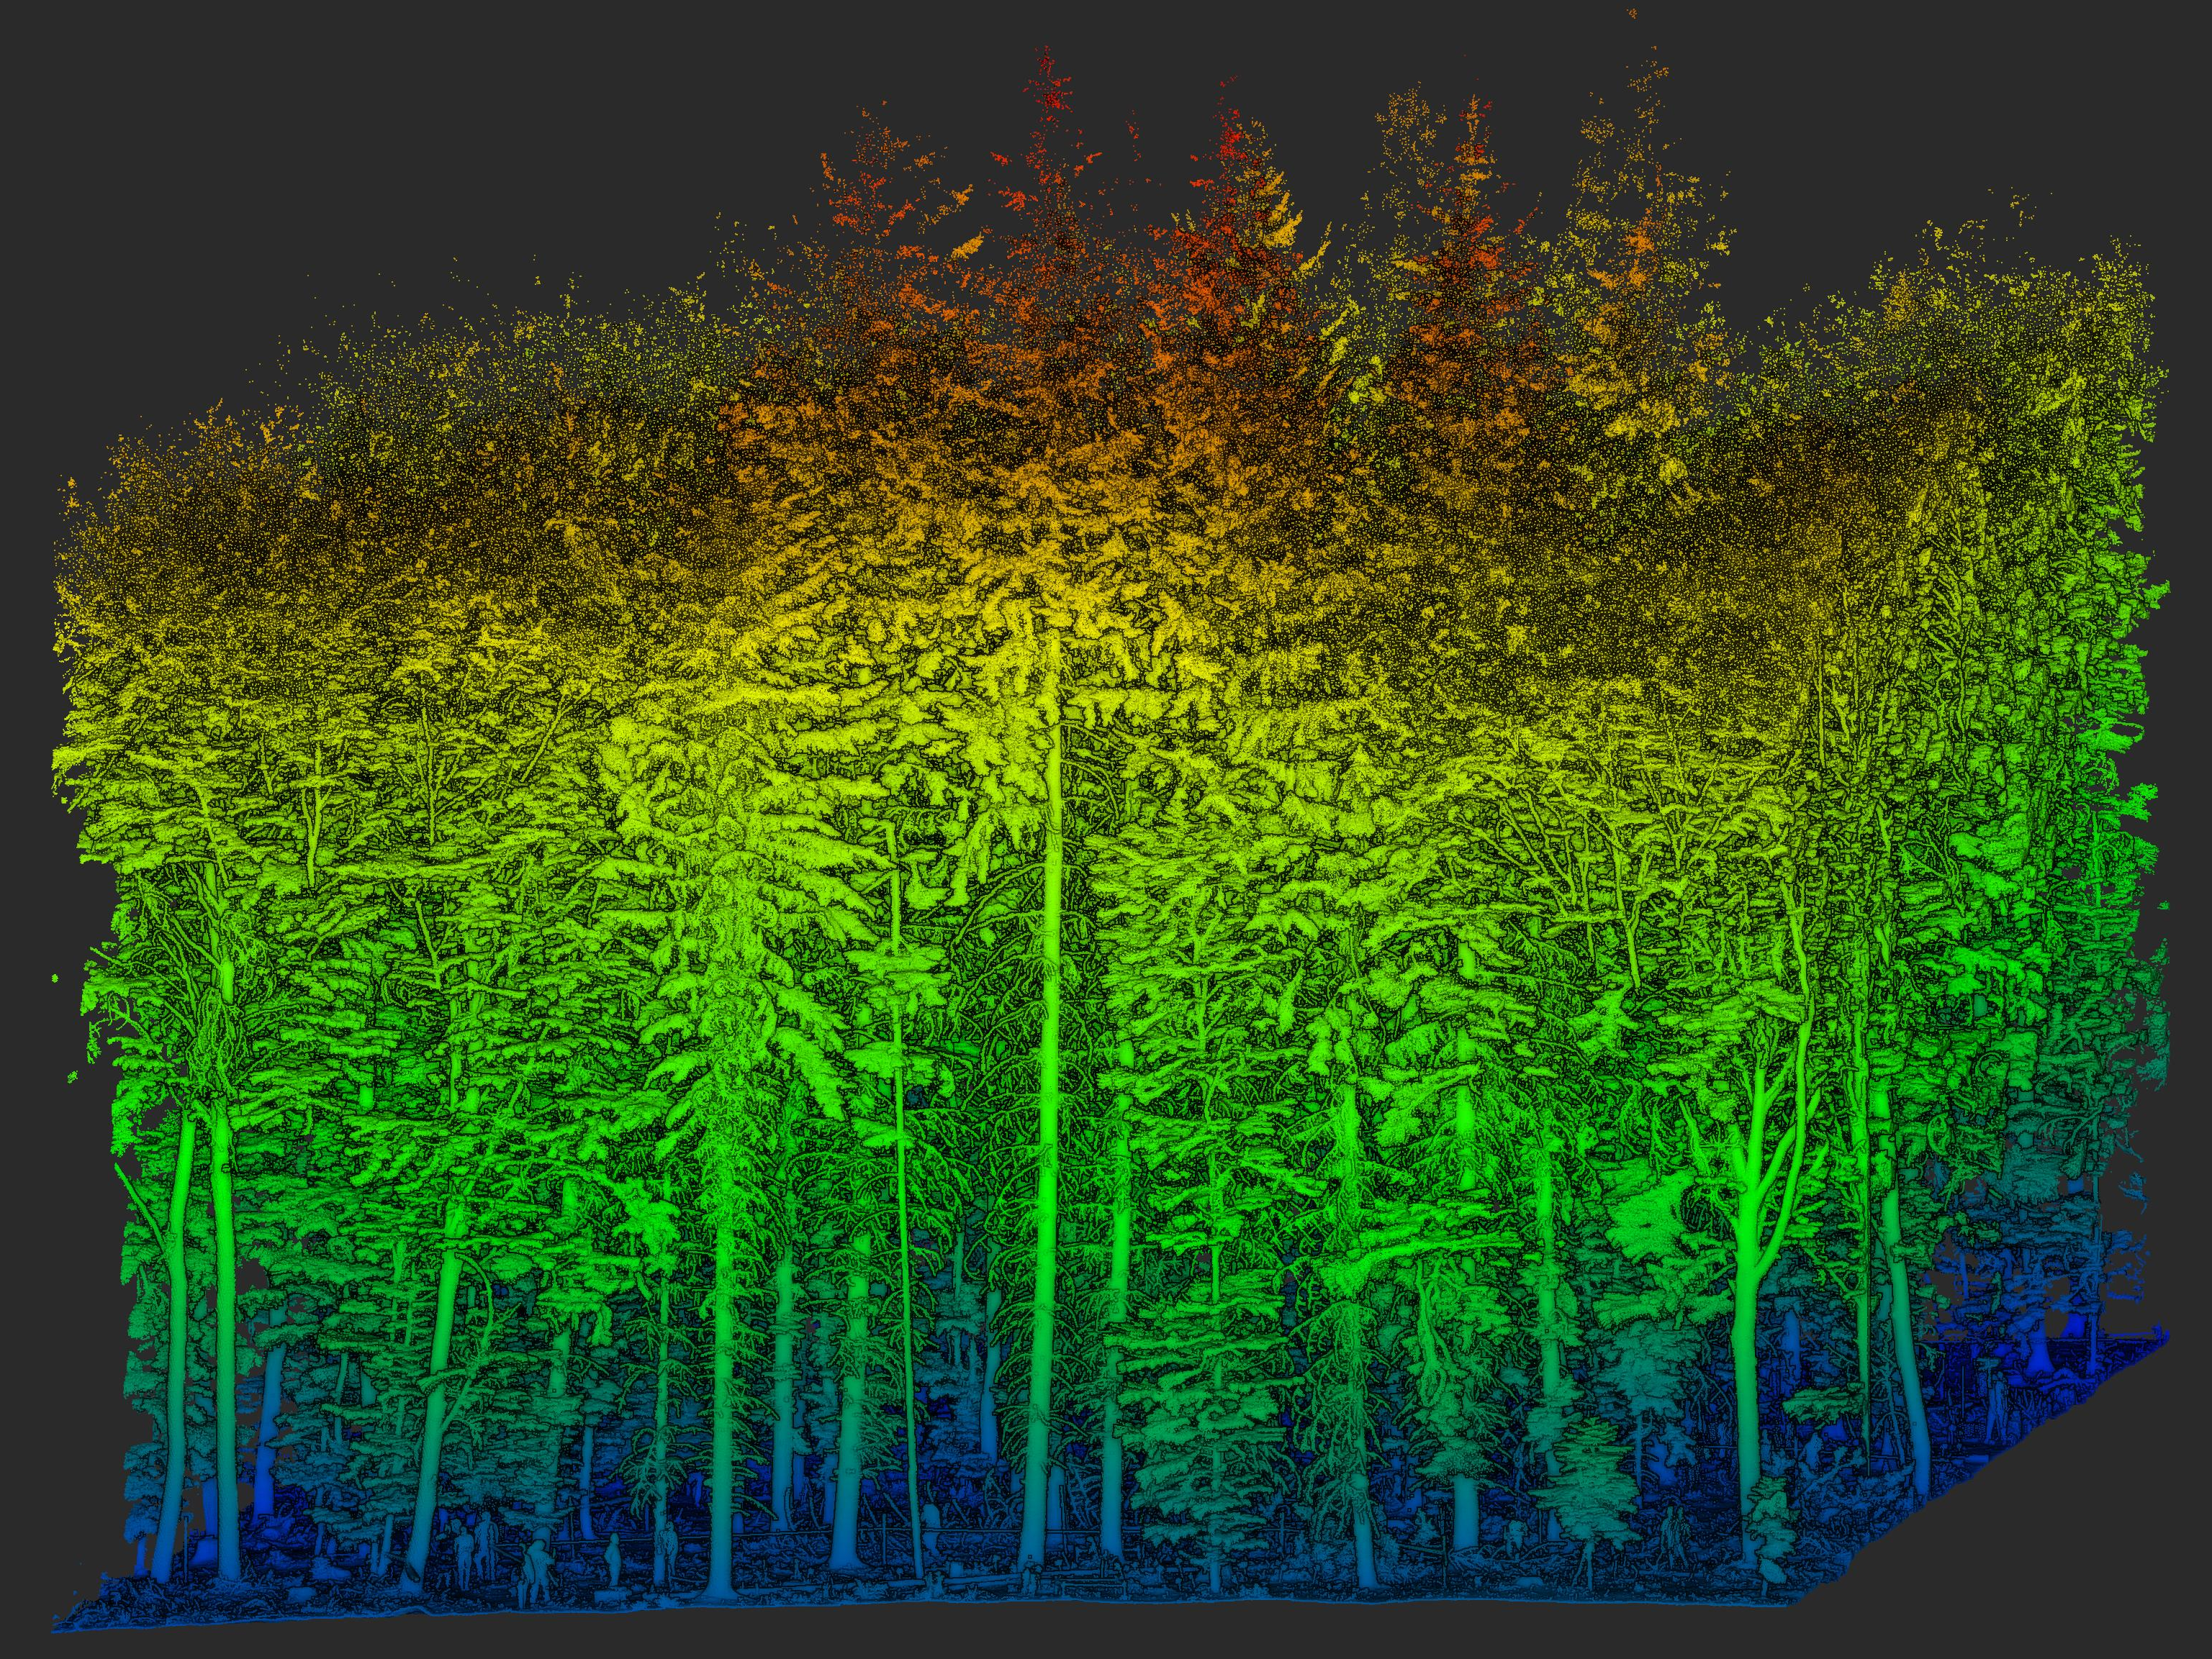
Point Clouds
Typical Sensors: LiDAR
Good for 3D representation
Unstructered data
More challenging for analysis
Allows more accurate representation

Slide 11


Slide 12


Slide 13
What sensor platforms exist?
08 – Introduction to Remote Sensing

Slide 14
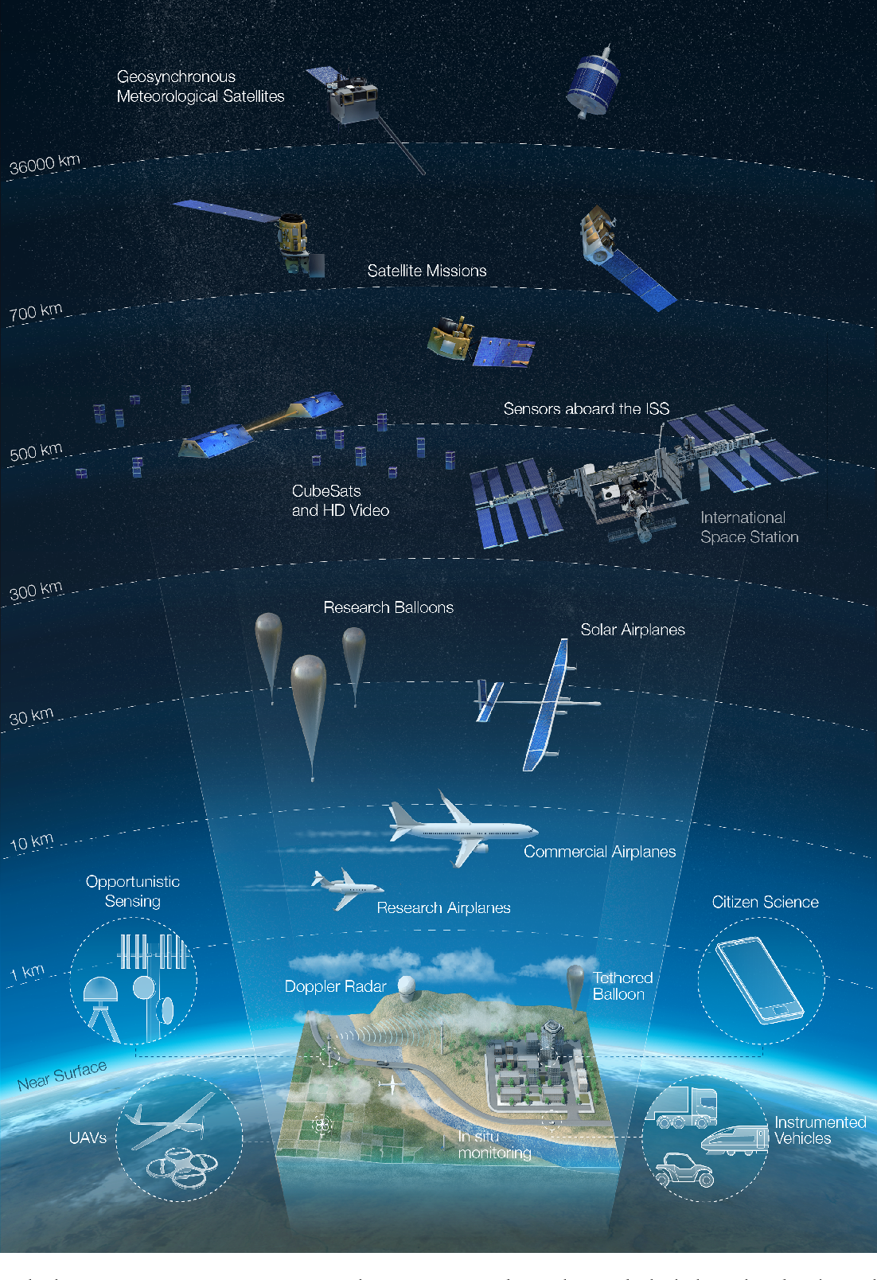
Sensor platforms
Spaceborne
Satellites, Space station
Airborne
Drones, Airplanes, Balloons
Terrestrial & close range
Smartphones, terrestrial LiDAR Camera traps, …
Coverage
Spatial detail

Slide 15
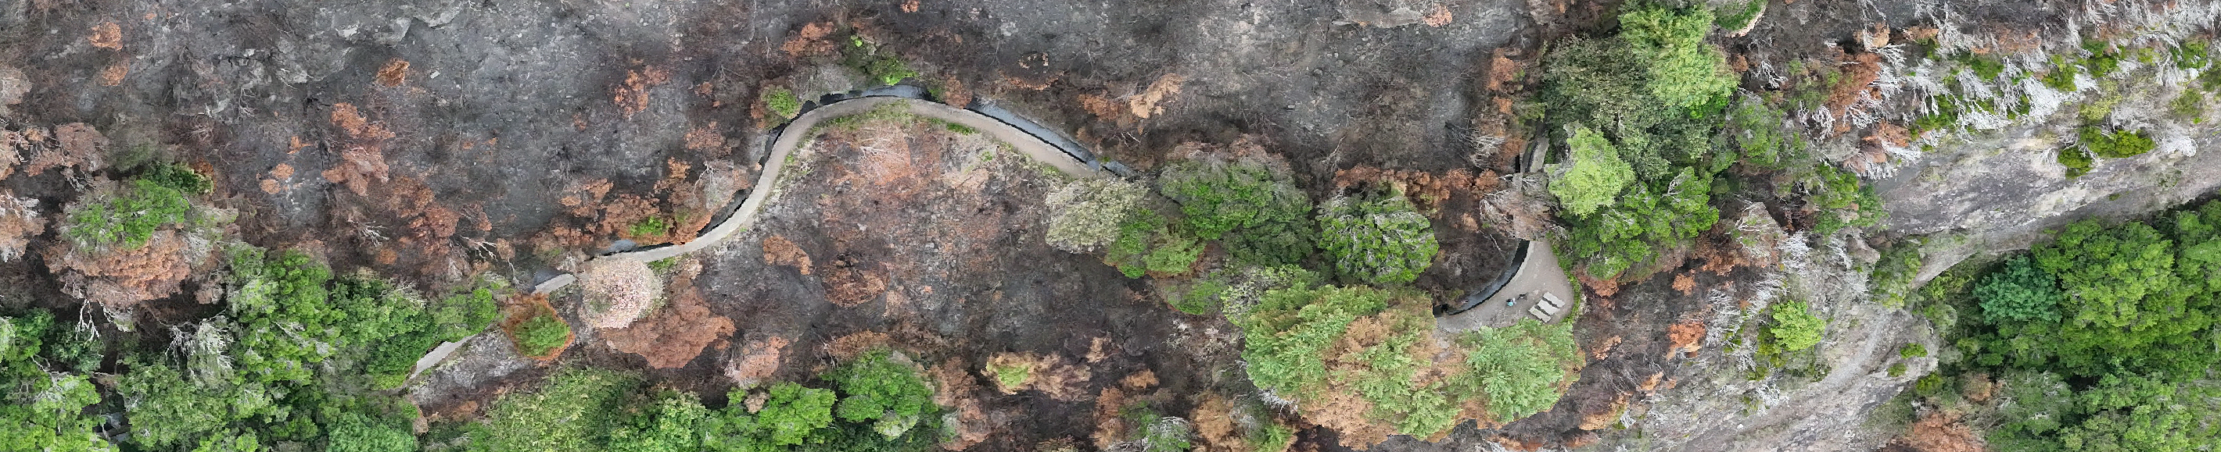
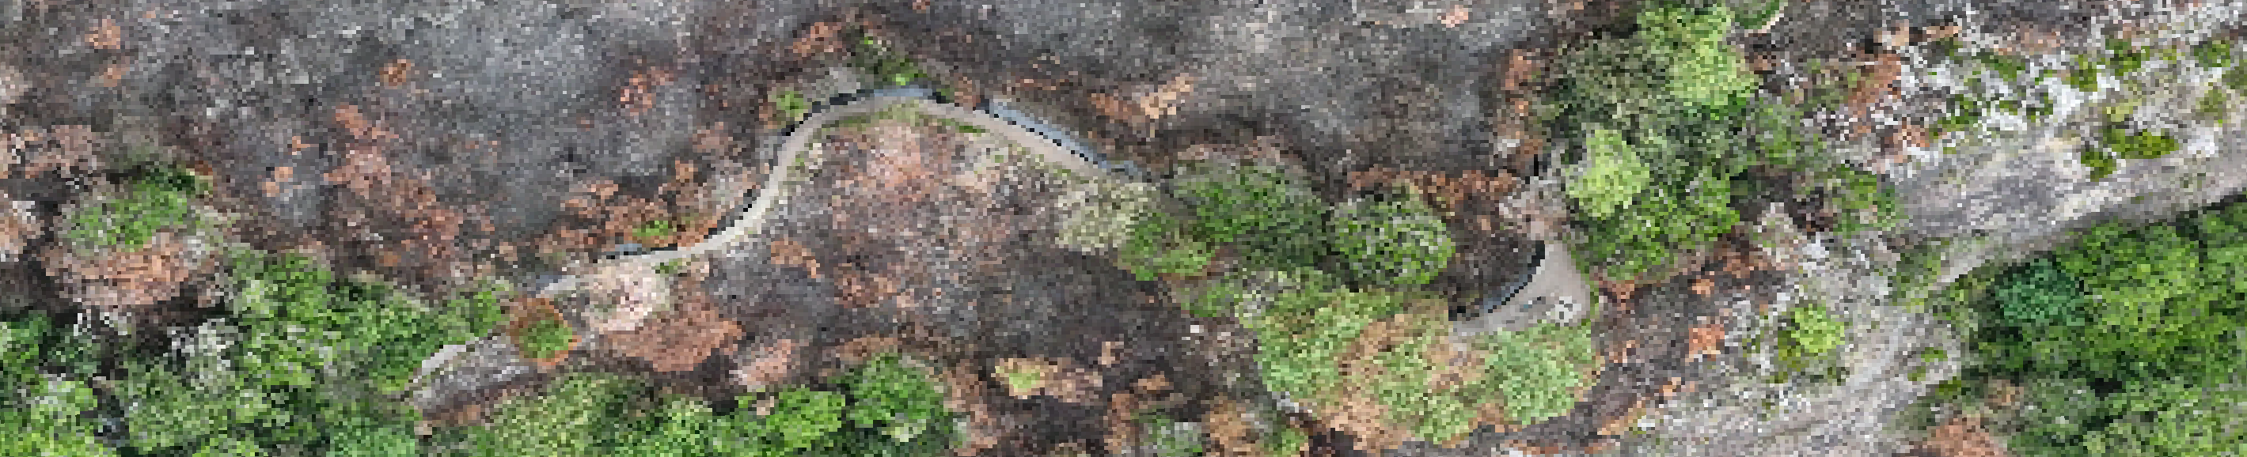

Sensor platforms
Drone (DJI Mavic 3E)
Commercial Copter
Pixel size: 0.03 m
Airplane
National Flight Surveys
Pixel size: 0.30 m
Spaceborne, Sentinel-2
ESA
Pixel size: 10 m
Pixel size
Coverage

Slide 16
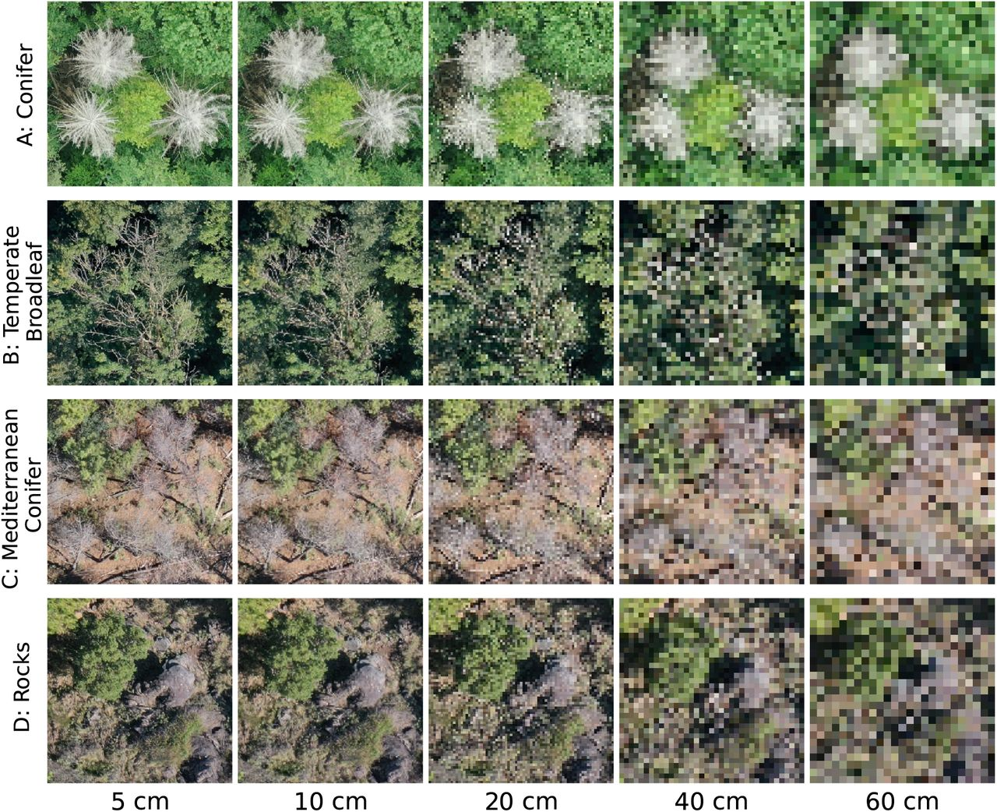
The importance of spatial resolution at the example of detecting dead trees.
Mosig et al. 2024

Slide 17
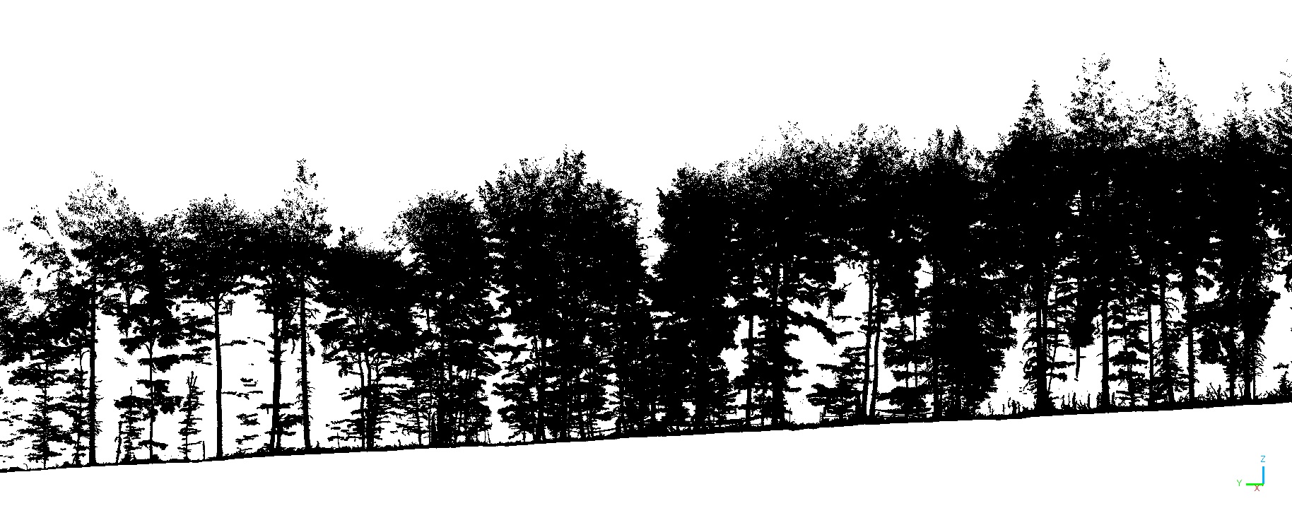

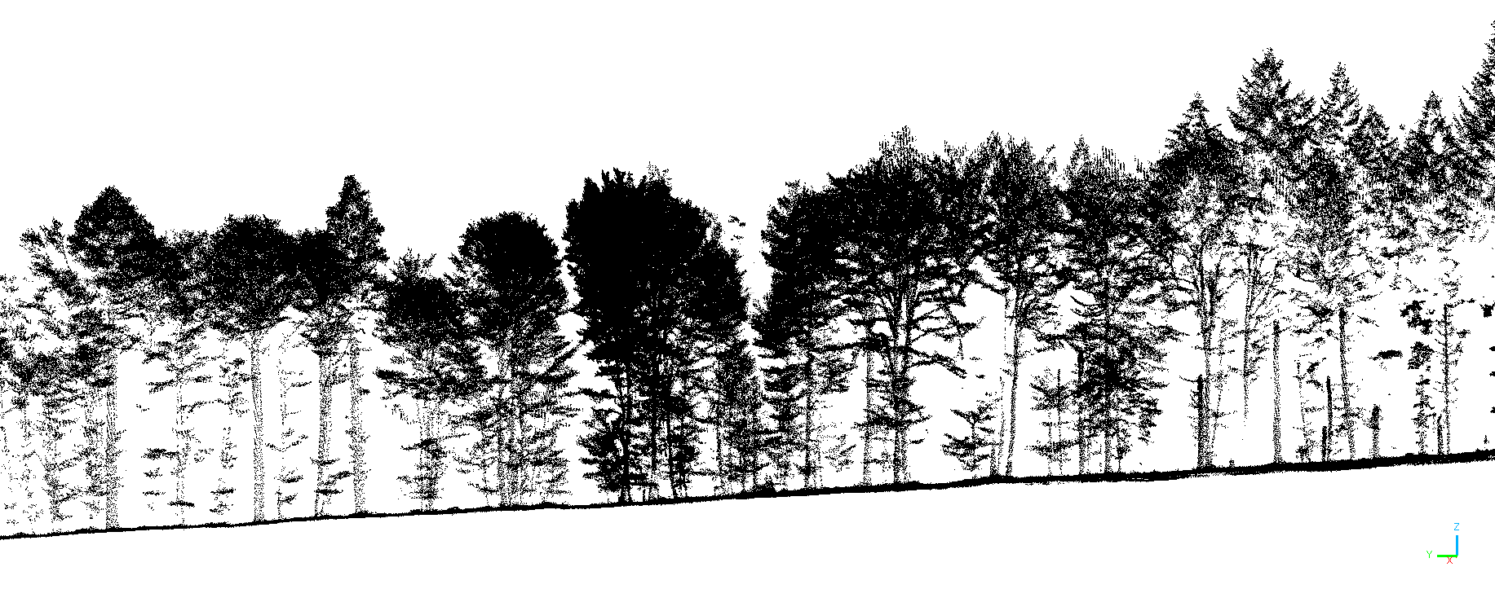

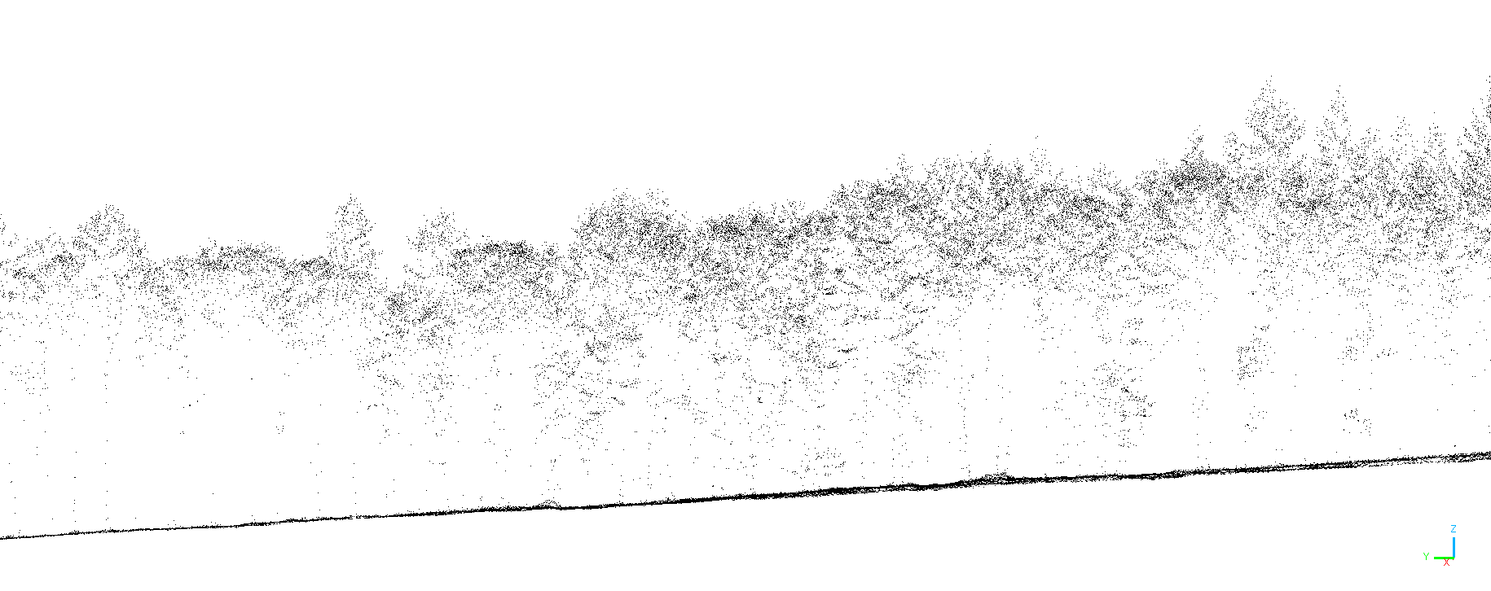

Sensor platforms
Terrestrial LiDAR (TLS)
Commercial system (Riegl)
ca. 2000 points / m³
Drone LiDAR (ULS, UAV-LiDAR)
Commercial system (Riegl)
ca. 500 points / m³
Airborne LiDAR (ALS)
National Aerial Survey Germany
ca. 80 points / m³
Pixel size
Coverage

Slide 18
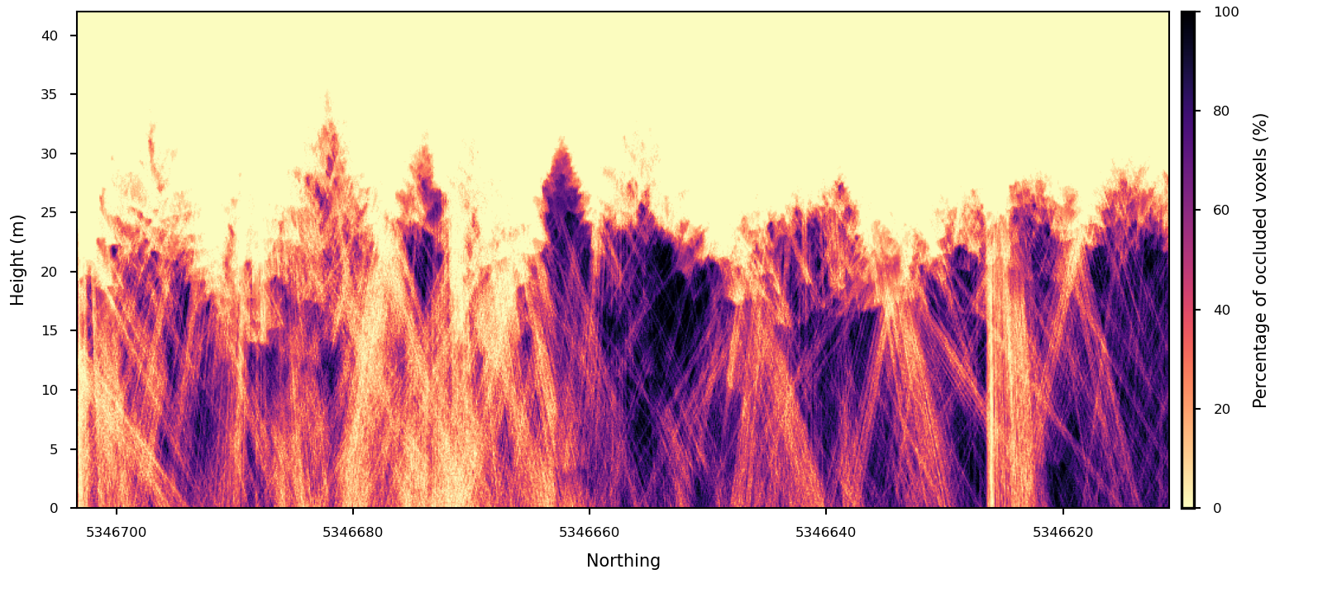
To see, or not to see, that is the question
LiDAR is a powerful technqiue for 3D sensing but it also has limits!
Gassiloud et al. 2024

Slide 20
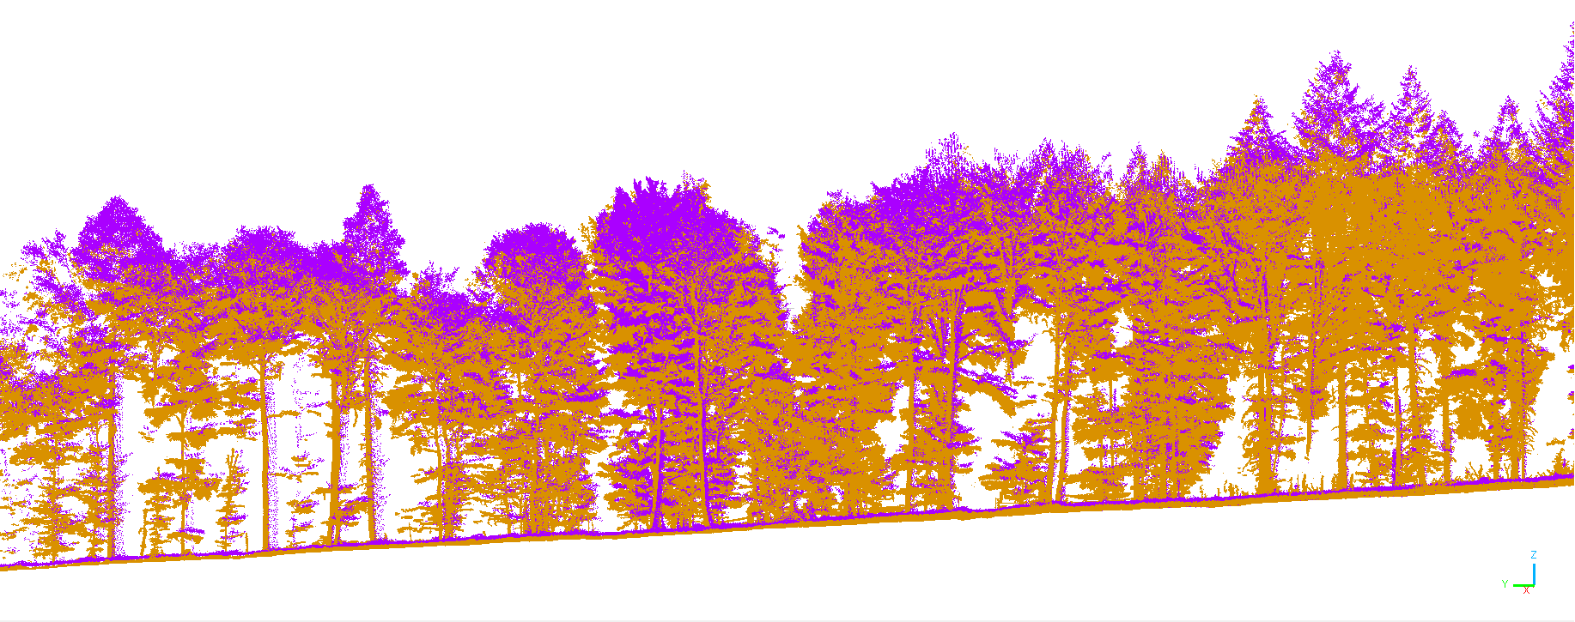

+

Slide 21
Best sensor & platform for forest inventories?
08 – Introduction to Remote Sensing

